Slide 1
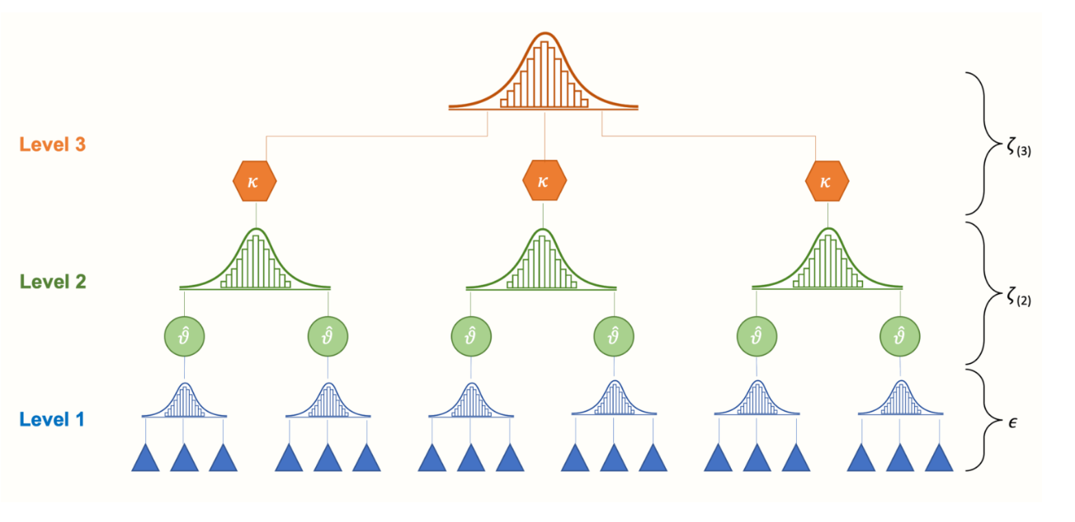
Multi-level Regression
Ekraj Pokhrel

Slide 2
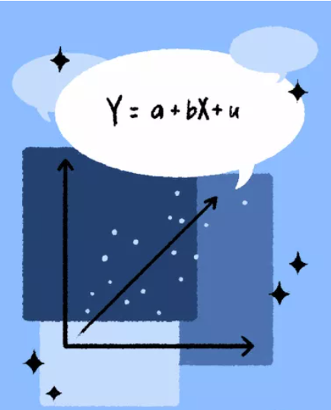
What is and Why Regression?
- Regression is a statistical method that used in wide range of field to determine the strength of the relationship between one dependent variable and one or several independent variable.
- Regression analysis is one of the most common techniques used to make prediction and classification.
Ekraj Pokhrel

Slide 3
What is Multi-level Regression Model? Also known as hierarchical linear models or mixed-effects models
Explicitly models the hierarchical structure of the data.
It allows for the inclusion of random effects that capture the variation between different levels of the data hierarchy
These random effects account for the correlation or dependence between observations within the same group or higher-level unit.
Ekraj Pokhrel

Slide 4
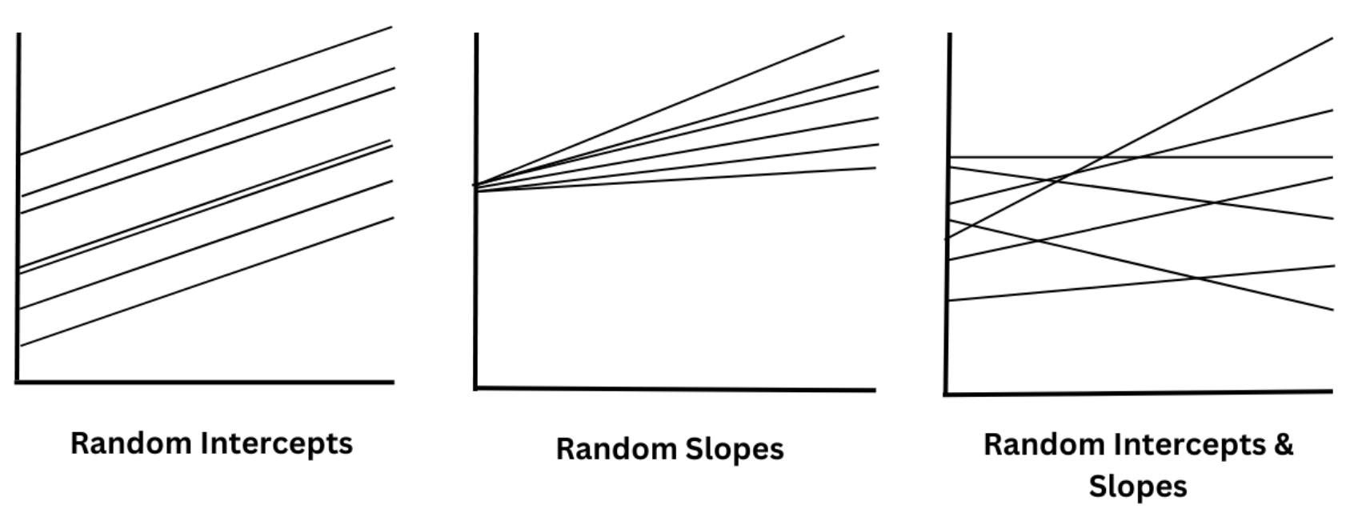
Multi-level Regression
Ekraj Pokhrel

Slide 5
Multi-level Regression: How to compute??
Which regression model would fit my dataset???
Well, if you want to find the answer in two line of code then, follow me
Ekraj Pokhrel

Slide 6
Multi-level Regression
Resourcs:
Pycaret Documentation: https://pycaret.gitbook.io/docs/get-started/quickstart#regression
https://www.mdpi.com/2076-3417/13/8/5180
https://en.wikipedia.org/wiki/Multilevel_model
https://www.analyticsvidhya.com/blog/2021/07/automl-using-pycaret-with-a-regression-use-case/
Dataset: https://www.kaggle.com/competitions/house-prices-advanced-regression-techniques/data?select=train.csv
Ekraj Pokhrel
Thank You !

